Slide 1





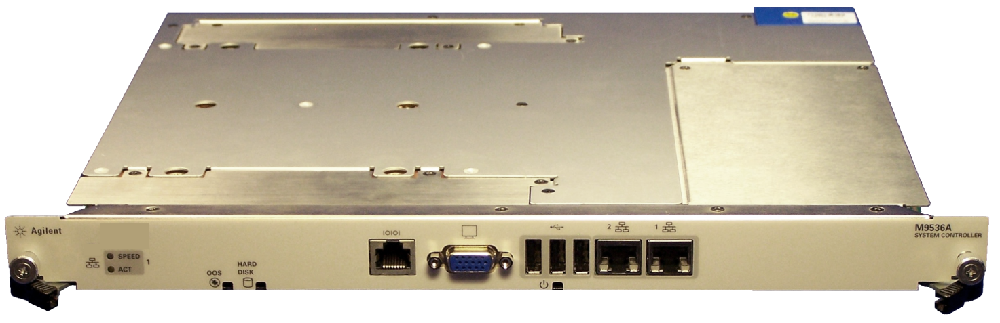
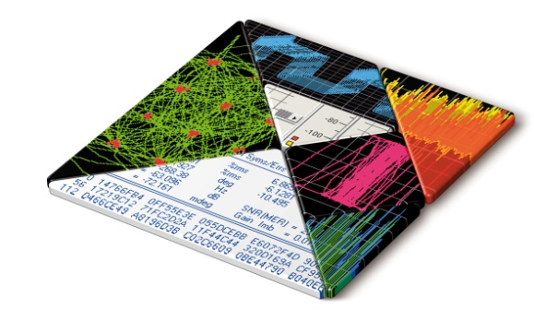
Agilent Modular Instrumentation
- New M9536A AXIe Embedded Controller
Dave Brannon, Product Marketing

Slide 2
AXIe Embedded Controller
Product Overview, key product features
Technical specs and block diagram
Product structure

Slide 3
Agilent M9536A AXIe Embedded Controller
The industry’s first AXIe embedded PC controller
Single-slot, AXIe controller
x4, PCIe Gen 2 link to AXIe backplane (2 GB/s data bandwidth)
Intel Xeon Quad Core processor @ 2.13 GHz
8 GB RAM (16 GB opt),
160 GB SSD
Operating system options: Win 7 (32-bit) and Win 7 (64-bit)
Comes pre-loaded with Agilent I/O libraries
Notes:
Panel connections: USB (3), 10/100/1000 LAN (2), VGA, Serial
This does not replace the embedded system module. It does not have the functions the ESM provides including power management, LAN and PCIe switching.

Slide 4
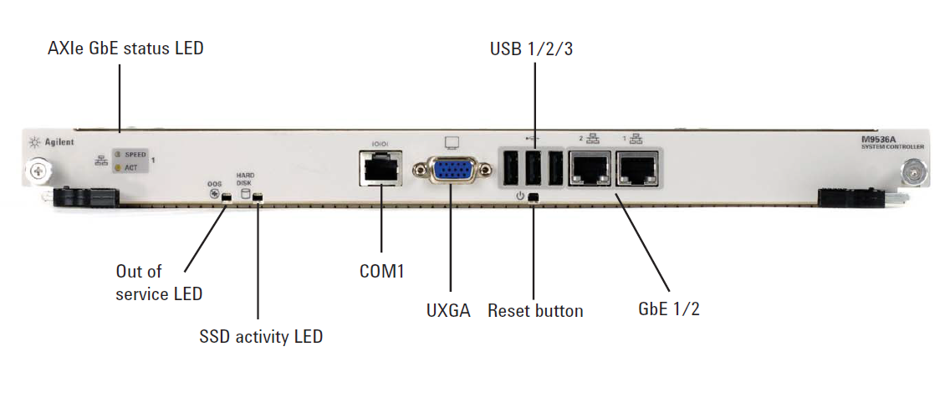
M9536A Front Panel Connections

Slide 5
Key Specifications
M9536A
CPU: | Intel Xeon L5518 Quad-core
Chipset | Intel 5520/ICH10R
CPU clock frequency | 2.13 GHz
Video | Type: Analog VGA (ATI ES1000 with 64 MB VRAM) Resolution: UXGA up to 1600 x 1200 resolution
Memory | L2 cache: 8 MB RAM type: Three DDR3-1333 240-pin RDIMM Sockets RAM capacity: 8 GB std, 16 GB opt, 24 GB Max
Storage | Type: 2.5" SATA II SSD Size: 160 GB
AXIe backplane I/O | PCIe link: Gen 2, x4 (2 GB./s max data rate) Ethernet: 10/100/1000BASE-T
Operating system support | Windows 7 (32- and 64-bit)
Pre-loaded software | Operating system and Agilent I/O libraries

Slide 6
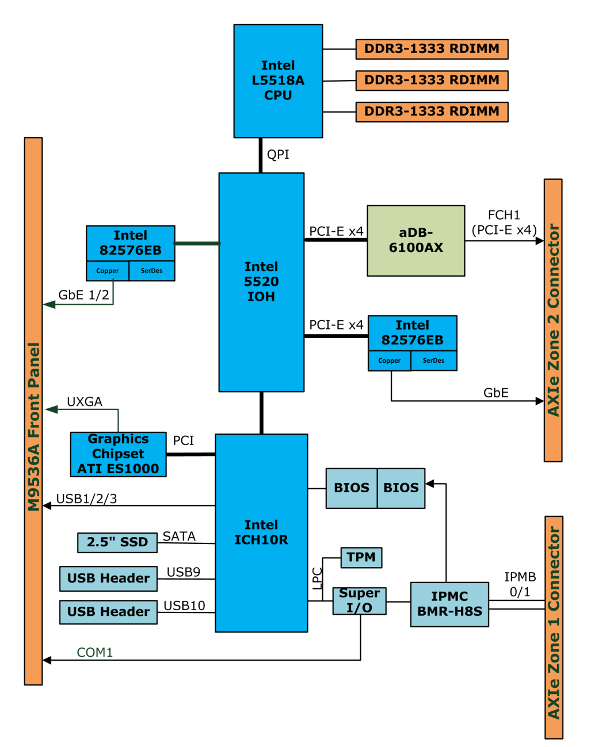
M9536A Block Diagram

Slide 7



Embedded Controller vs. External Controller
External PC
Benefits:
Highest CPU performance for the price
Most flexible I/O solution
Larger memory
More internal slot
Lots of choices and form-factors
Embedded PC
Benefits:
Designed specifically for modular systems
Supported by Agilent WW
Transportable embedded solution
Less rack space, compact size
Potential for higher chassis data rate
AGILENT CONFIDENTIAL
DISCOVER the Alternatives… …Agilent MODULAR Products

Slide 8
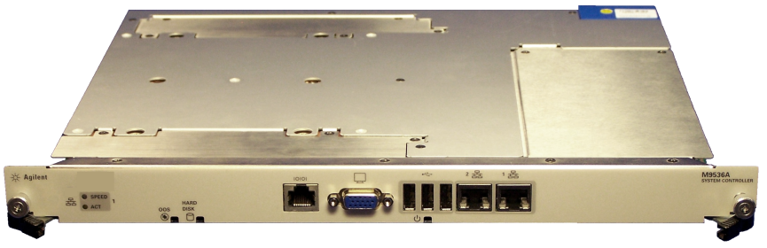
Product structure and pricing
Model Number | Description | US List Price
M9536A | AXIe Embedded PC Controller | $8,900
M9536A-M16 | Memory upgrade from 8 GB RAM to 16 GB RAM | $900
M9536A-W76 | Windows 7 operating system (64 bit) | $0
M9536A- W73 | Windows 7 operating system (32 bit) | $0
Y1207A | Spare SSD: Win 7/32 | $1400
Y1208A | Spare SSD: Win 7/64 | $1400

